Slide 1
FIREARM VIOLENCE IN SPRINGFIELD OHIO
PRESENTED BY
CALEB PERKINS, MSW, LSW

Slide 2
WHO I AM & WHY I’M HERE
GUN VIOLENCE PREVENTION COORDINATOR
  $1.6 MILLION GRANT THROUGH THE DEPARTMENT OF JUSTICE
  PART OF THE FEDERAL GOVERNMENT’S COMMUNITY-BASED VIOLENCE INTERVENTION AND PREVENTION INITIATIVE (CVIPI)
  CVIPI CONFERENCE IN CHICAGO
PROGRAM NAMING CONTEST IN SCHOOLS
COMMUNITY ASSESSMENT & COMMUNITY AWARENESS
STRATEGIC PLANNING
PROGRAM INITIATION

Slide 3









FOUNDING ORGANIZATIONS

Slide 4
A NATIONAL CONCERN
U.S. SURGEON GENERAL DECLARED FIREARM VIOLENCE A PUBLIC HEALTH CRISIS ON 6/25/2024
  LEADING CAUSE OF DEATH FOR 1-19 YEAR OLDS ¹
  300 MASS SHOOTINGS IN 2024 AS OF 6/26/2024 (A MASS SHOOTING IS DEFINED AS 4+ INJURIES/FATALITIES, NOT INCLUDING ASSAILANT) ²
  BLACK AMERICANS ARE 11.5X MORE LIKELY TO BE VICTIMS OF FIREARM HOMICIDE THAN THEIR WHITE COUNTERPARTS
    BLACK MEN 18-24 ARE 23X MORE LIKELY THAN THEIR WHITE COUNTERPARTS ³
  FROM 2019 TO 2022, 15-24 YEAR OLDS MADE UP THE HIGHEST AVERAGE VISITORS TO EMERGENCY ROOMS FOR FIREARM INJURIES ⁴
1. Goldstick JE, Cunningham RM, Carter PM. Current Causes of Death in Children and Adolescents in the United States. N Engl J Med. 2022 May 19;386(20):1955-1956. doi: 10.1056/NEJMc2201761
2. https://www.gunviolencearchive.org/reports/mass-shooting
3. https://www.bradyunited.org/resources/research/disproportionate-impact-gun-violence-black-americans
4. https://www.cdc.gov/mmwr/volumes/73/wr/mm7324a3.htm

Slide 5
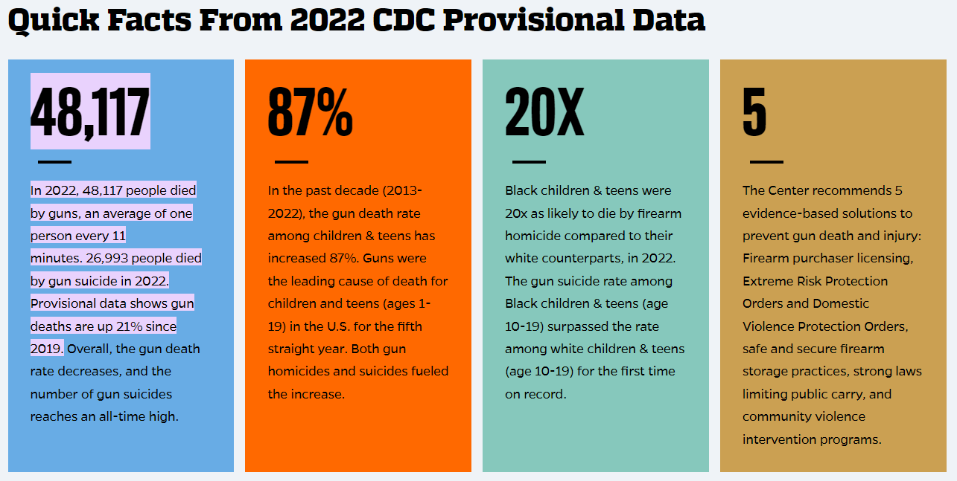
Source: https://publichealth.jhu.edu/center-for-gun-violence-solutions#:~:text=48%2C117,are%20up%2021%25%20since%202019.

Slide 6
Source: Firearm Violence: A Public Health Crisis in America – The Surgeon General’s Advisory 2024

Slide 7
A SPRINGFIELD CONCERN
CLARK COUNTY DISPATCH RECEIVED 1,170 SHOTS FIRED CALLS BETWEEN 3/1/2023 – 6/30/2024 (880 WERE IN SPRINGFIELD)
  SPRINGFIELD ACCOUNTED FOR 75.21% OF THE COUNTY TOTAL
518 FIREARM INCIDENTS IN SPRINGFIELD THAT RESULTED IN ARREST/CHARGES BETWEEN 1/1/2021 – 12/31/2023
  2021: 165 | 2022: 181 | 2023: 172
76 SHOOTINGS RESULTING IN DEATH OR INJURY BETWEEN 3/1/2023 – 6/30/2024 IN CLARK COUNTY (65 OF THOSE WERE IN SPRINGFIELD)
  SPRINGFIELD ACCOUNTED FOR 85.52% OF THE COUNTY TOTAL
82 FIREARM THEFTS FROM 1/1/2023 – 6/11/2024 IN SPRINGFIELD
  56 TOTAL THEFTS IN 2023

Slide 8
A SPRINGFIELD CONCERN

Slide 9
A SPRINGFIELD CONCERN

Slide 10
A SPRINGFIELD CONCERN

Slide 11
A SPRINGFIELD CONCERN

Slide 12
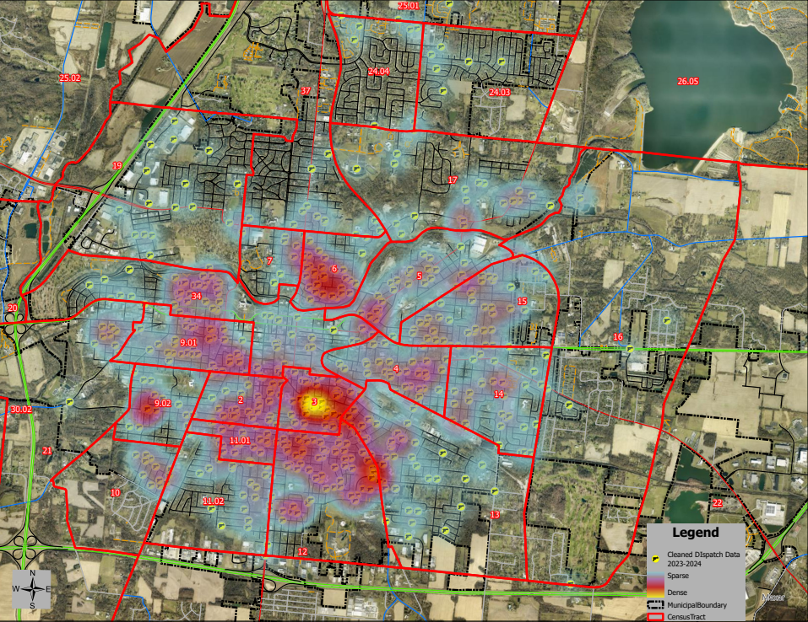

Slide 13
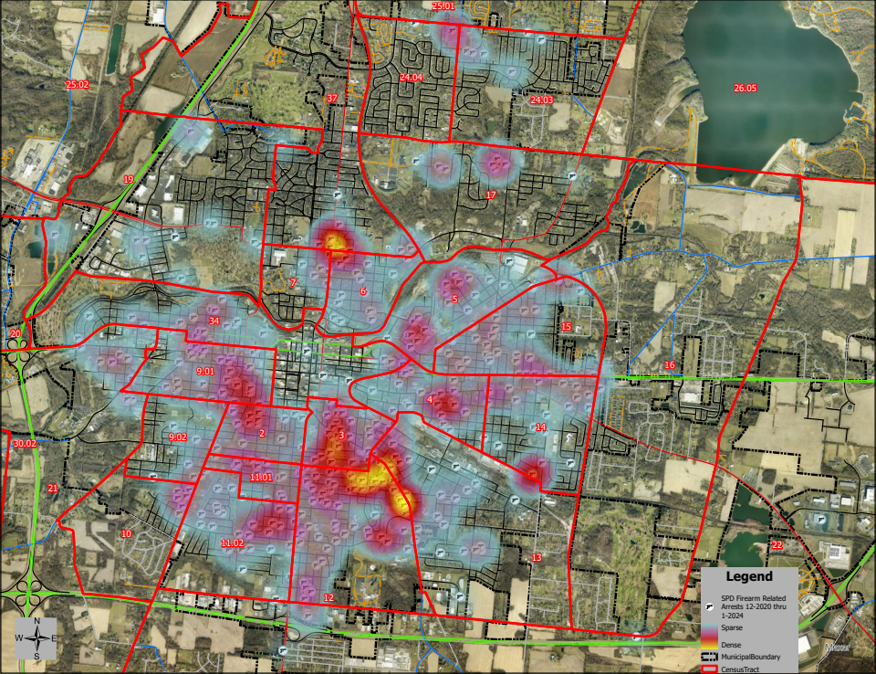

Slide 14
QUESTIONS

